Slide 1
San Francisco Employee Data Prediction
Group 285
Vaidehi Rathkanthiwar
Data Analytics

Slide 2
Introduction
One of the most important aspects of running your business is keeping your employees happy by offering them high-quality employee benefits and compensation.
So, there must be some solution in which company can know in advance about the compensation structure based on job profile and organization.
Employers can use this model to imbibe some knowledge regarding the compensation factors and employees can use it to decide which job profiles are receiving maximum benefits

Slide 3
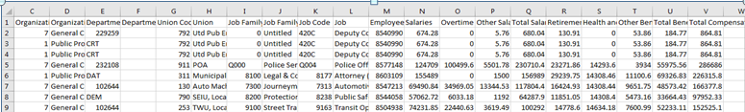
Dataset
Our dataset has 1 file with 835308 instances and 22 columns.
Predicting Salary
Predicting Total Compensation

Slide 4
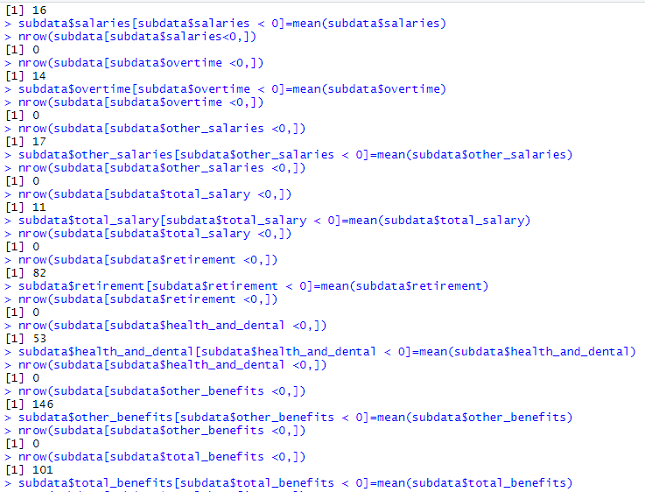
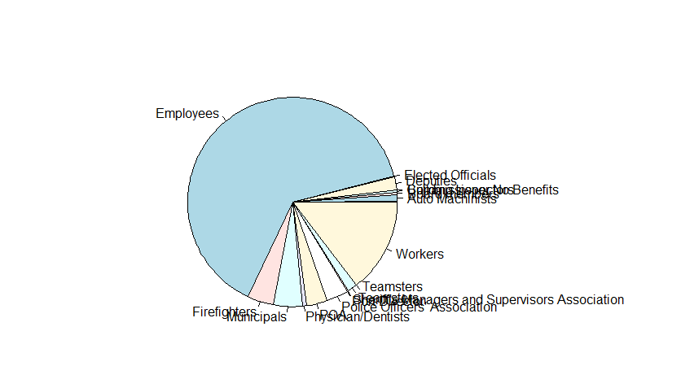
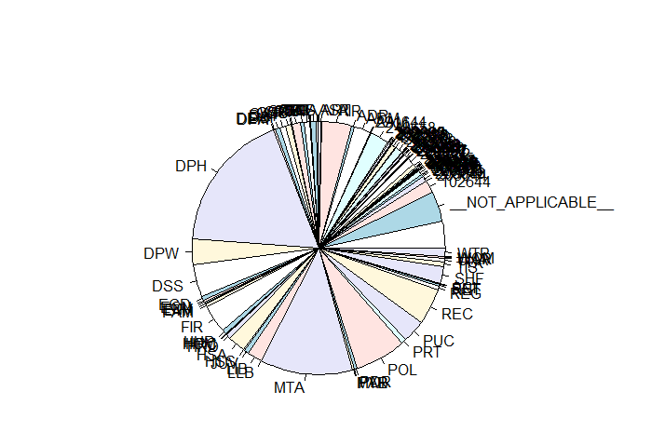
Preprocessing
Checking negative values
Preprocessing | Column Names
Negative Values | Salaries, Overtime, Other Salaries, Retirement, Other Benefits
Not Applicable, Blanks, Missing Values | Department Code, Union
CRF (Union)
CRF (Department Code)

Slide 5
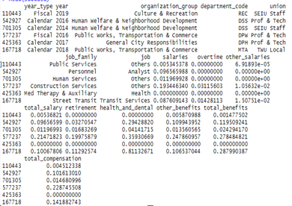
Preprocessing
Columns after pre processing
Preprocessing | Column Names
Removal of unnecessary Columns | Employee Identifier Job family code Union code Department Organization group code Job code
Normalization | Salaries Overtime Other Salaries Total Salaries Retirement Health and Dental Other Benefits Total Compensation

Slide 6
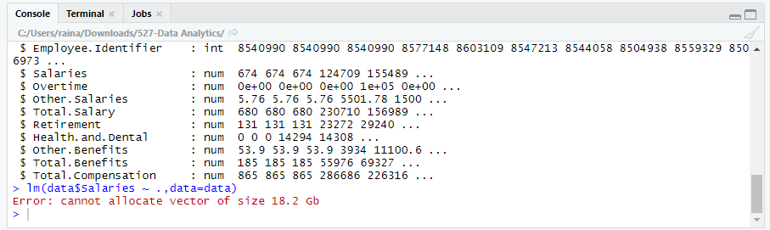
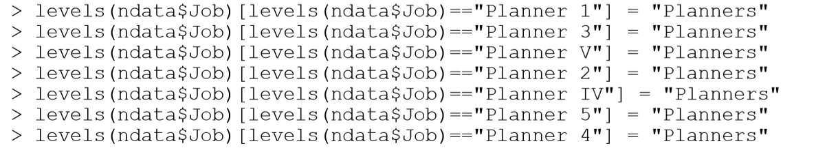
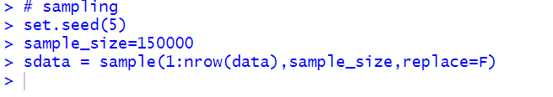
Issues while loading the dataset
Solutions :
A) Grouping (Job, Job Family, Union)
B) Sampling(150000)

Slide 7
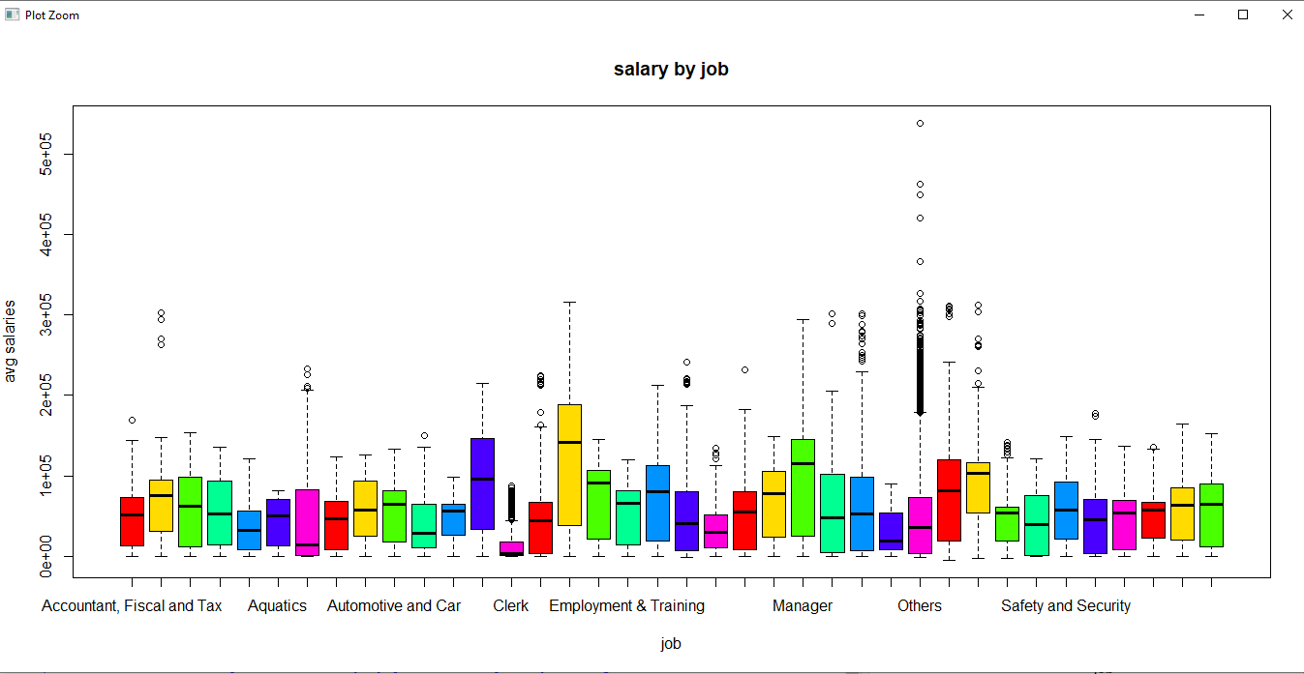
ANOVA and Hypothesis Testing for Job
Boxplot for Salaries vs Job

Slide 8
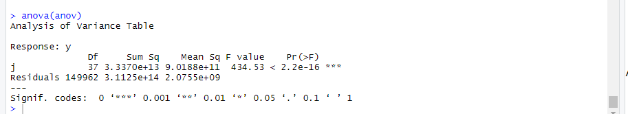
ANOVA and Hypothesis Testing for Job
Null hypothesis : All the average salaries for jobs are equal
Alternate hypothesis : Not all the average salaries for jobs are equal
At 95% confidence level, p-value is less than 0.05, we can reject null- hypo and conclude that avg salaries are not all equal.

Slide 9
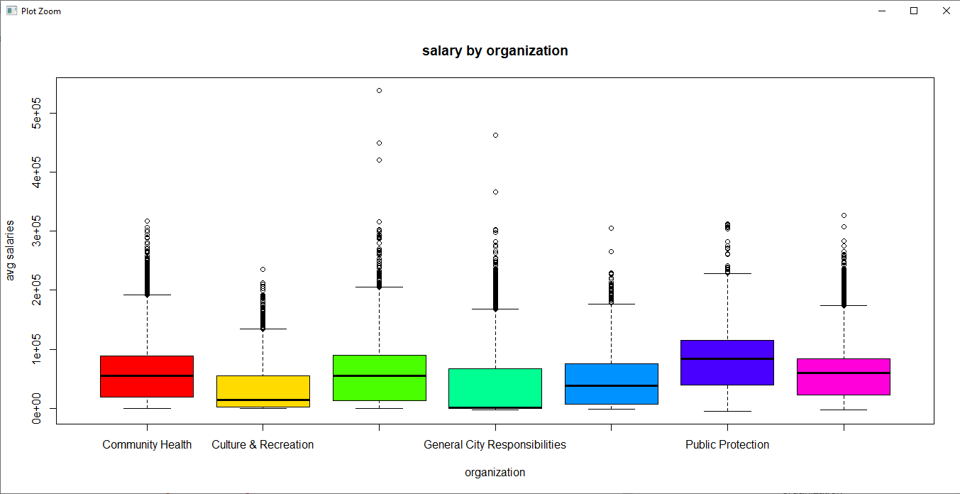
Mean comparison for Organization_group
Boxplot for Salaries vs Organization_group

Slide 10
Mean comparison for Organization_group
Salaries and organization_group
We can compare means in box pot as variation is almost same in all the cases.
Public Protection group has the maximum average salaries.

Slide 11
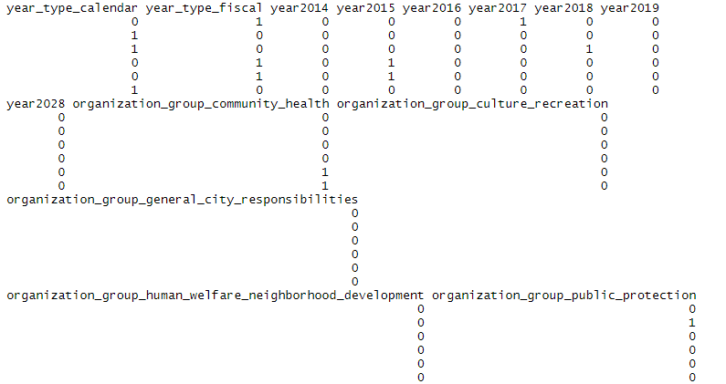
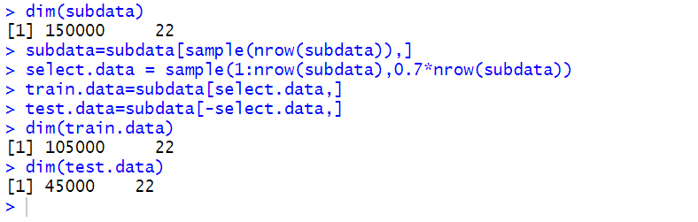
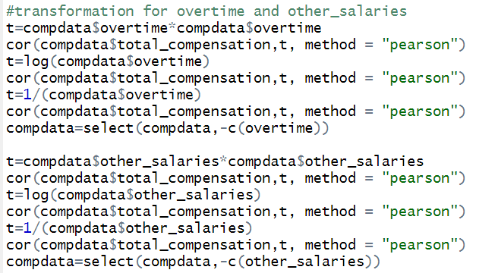
Building Models for Predicting Total Compensation
Dummy variables
Hold Out Evaluation
Weak Co relations and Transformation

Slide 12

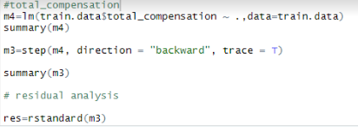
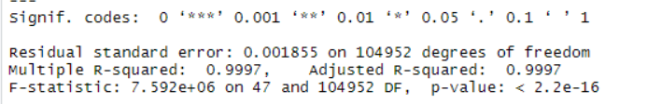
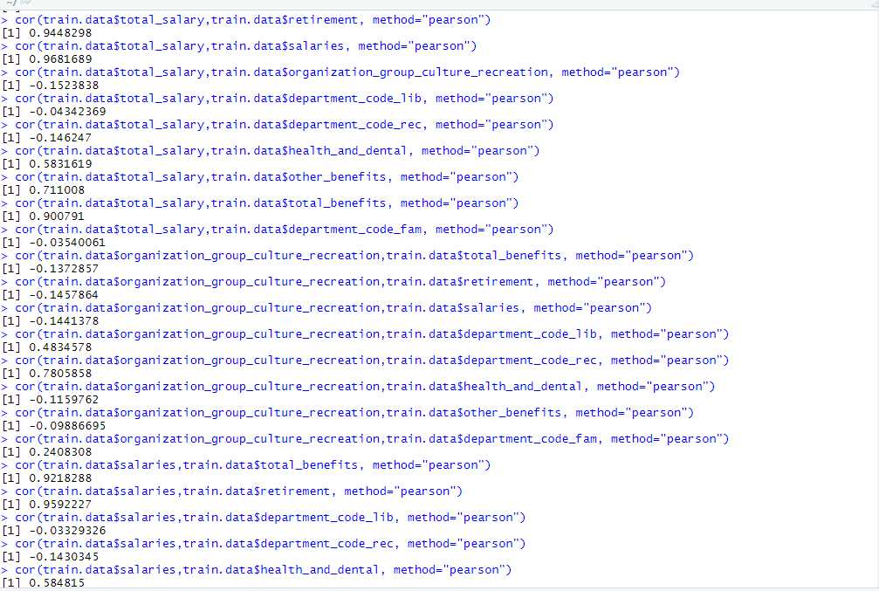
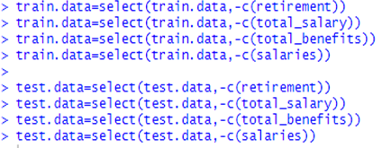
Predicting Total Compensation
Search Algorithm - Backward Elimination,
Feature Selection Criteria - AIC
Model 1
Checking multi co linearity using VIF
Removal of columns

Slide 13
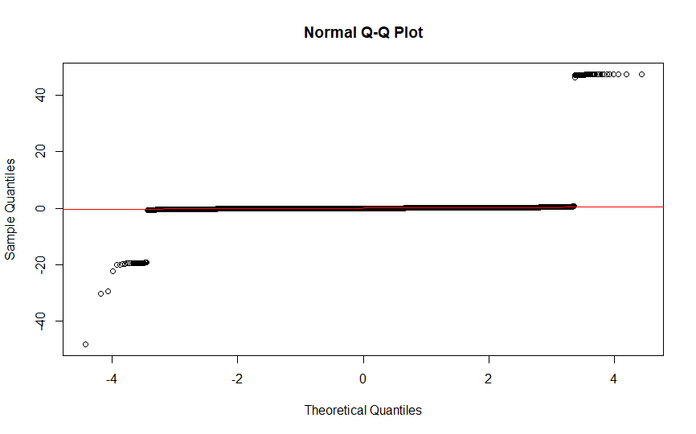
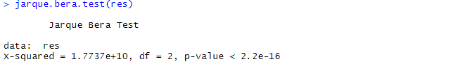
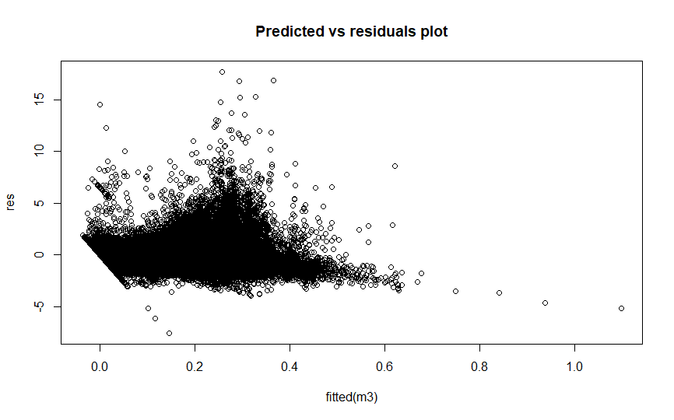
Predicting Total Compensation
(Residual Analysis)
JarqueBera Test
Normality test
Residual Plot (constant variance)

Slide 14
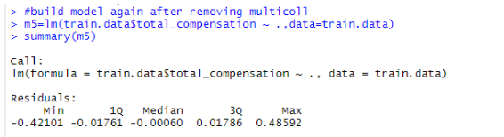

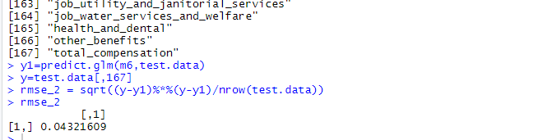
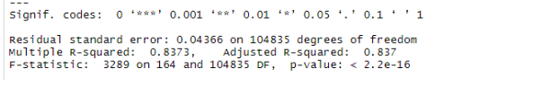
Predicting Total Compensation
Search Algorithm - Backward Elimination,
Feature Selection Criteria - AIC
Model After resolving multi-collinearity
RMSE

Slide 15
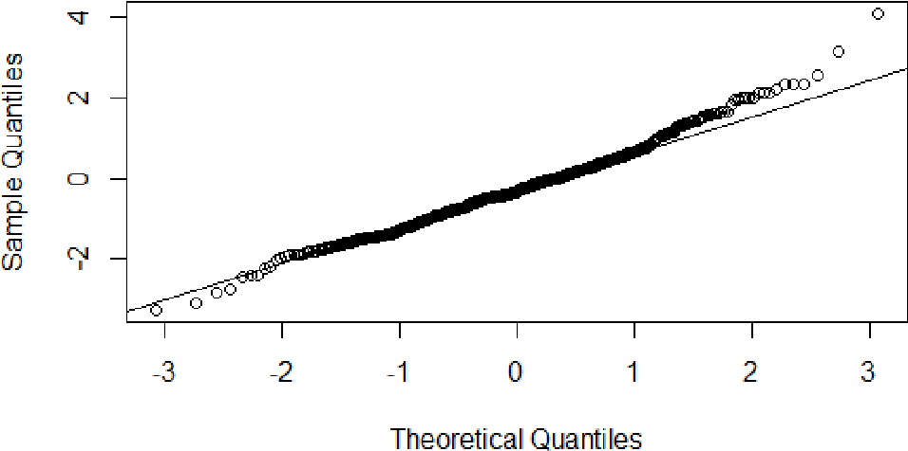
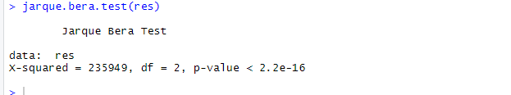
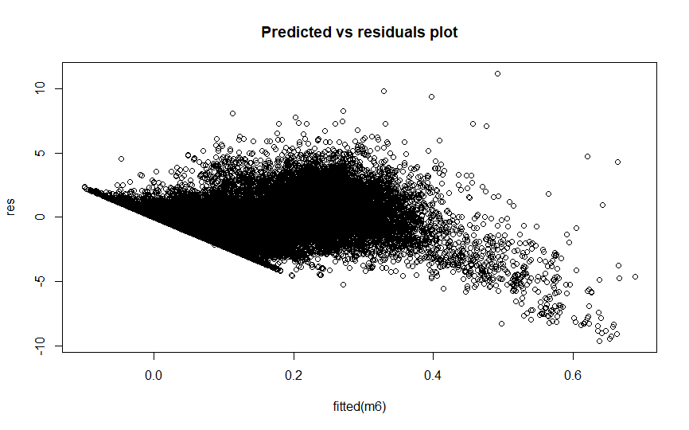
Predicting Total Compensation
(Residual Analysis)
JarqueBera Test
Normality test
Residual Plot (constant variance)

Slide 16
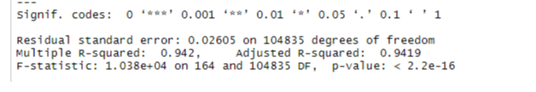
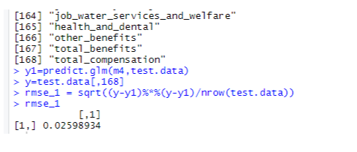
Predicting Total Compensation
Search Algorithm - Forward Selection,
Feature Selection Criteria - AIC
Similarly we built the final model with forward selection using AIC whose specifications are as below:
Ajd-R2
RMSE

Slide 17
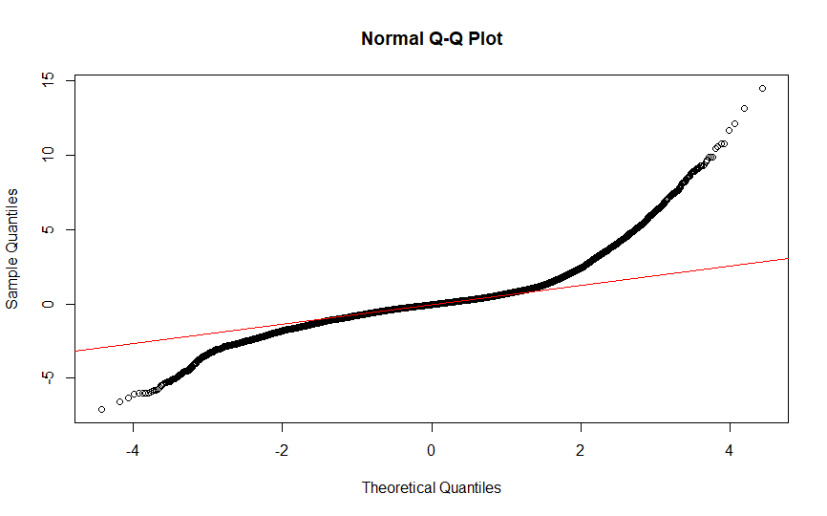
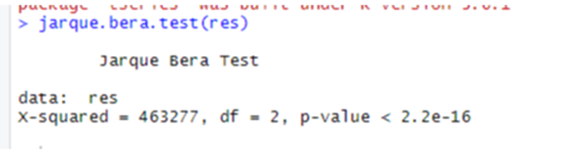
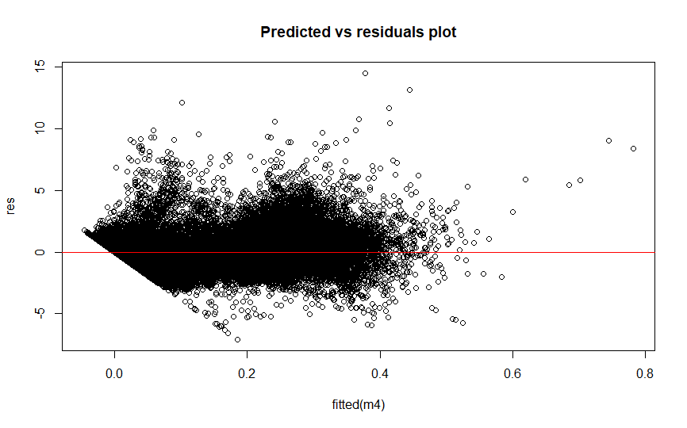
Models (Forward Elimination by AIC) Total Compensation
QQ Plot and Variance (Model 1)
Jarque bera

Slide 18
Best Model for Total Compensation (Forward And Backward Comparison )
ADJ R2
RMSE
Model 1 Backward | Model 2 Forward
0.837 | 0.9419
0.0431 | 0.0259
Here, we can see Adj R2 is better for Forward model, so we will choose that model

Slide 19
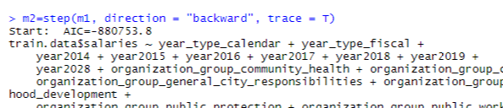

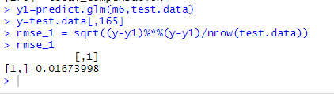
Predicting Salary
Search Algorithm - Backward Elimination,
Feature Selection Criteria - AIC
Like Total Compensation, we built the model for Salary and following are the different metrics we got.
RMSE

Slide 20
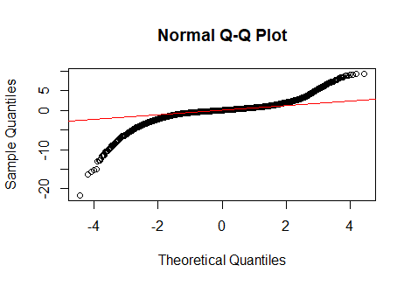
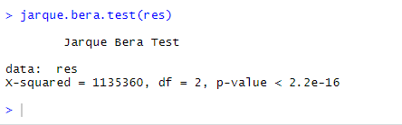
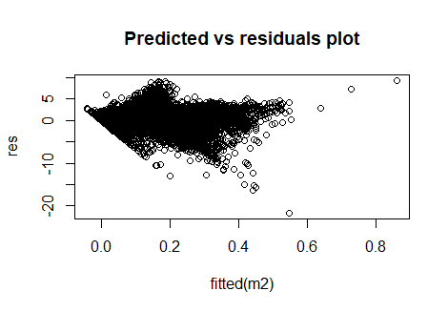
Predicting Salary
(Residual Analysis)
Normality test
Jarque Bera Test
Residual Plot (constant variance)

Slide 21
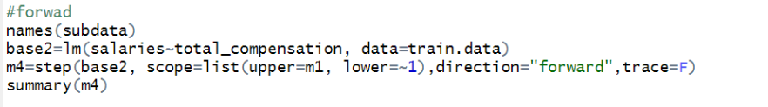
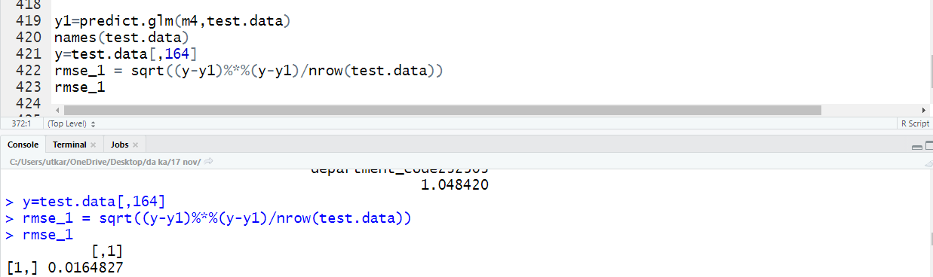
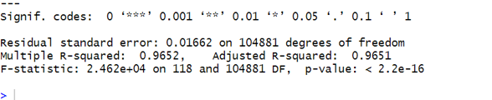
Predicting Salary
Search Algorithm - Forward Selection,
Feature Selection Criteria - AIC
Similarly we built the final model with forward selection whose specifications are as below:
RMSE
Ajd-R2

Slide 22
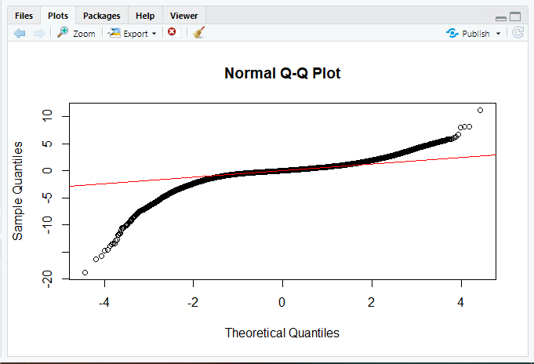
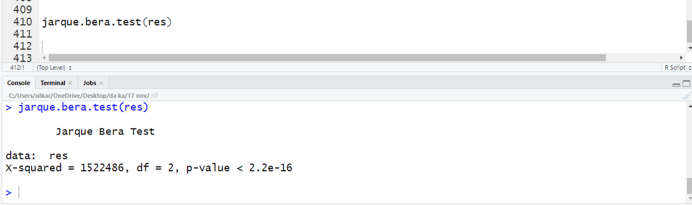
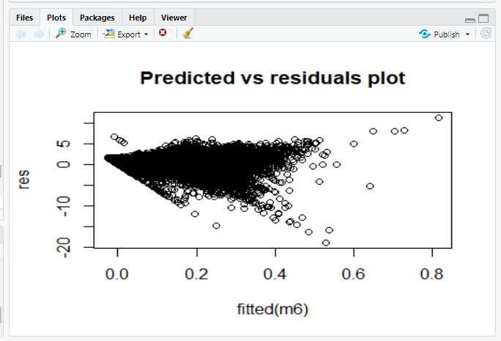
Predicting Salary
(Residual Analysis)
Jarque Bera Test
Normality test
Residual Plot (constant variance)

Slide 23
Best Model for Total Salary (Forward And Backward Comparison )
ADJ R2
RMSE
Model 1 Backward | Model 2 Forward
0.9658 | 0.9651
0.0167 | 0.0164
Here, we can see Adj R2 is slightly better for Backward model, so we will choose that model

Slide 24
Future Scope
Grouping of the job profiles in a better way in order to provide best association.
Individual parameter test for each job profile in ANOVA testing in order to build better prediction model.
Treatment of influential points; due to large dataset, influence measures wasn’t giving proper results for influence points, so we can do it better on proper systems with enhanced specifications.
Employees can use the predictive model to imply better strategies in terms of better job search which can provide better compensation and salary.
Similarly, Employers can decide what compensation and salary should be given to the job seeker based on job and other factors in order to optimize their financial status.

